Slide 1
Unit IV
GOF Design Patterns

Slide 2
Introduction
Object Oriented Analysis (OOA)
domain problem designed as (domain) objects
  – addresses the functional challenges
  – what a system does
  – provides guidance for implementation
Object Oriented Design (OOD)
● domain problem solved as (implementation) objects
  – addresses the implementation challenges
  – how a system realizes OOA

Slide 3
Introduction
How can we improve OOD:
identify common characteristics
– creation, structure, behaviour & interactions
design patterns (design reuse)
– generic blueprints (micro architecture)
– language and implementation independent
Two main catalogues
GoF: Gang of Four (Gamma, Helm, Johnson, Vlissides, 1995)
POSA: Pattern Oriented Software Architecture

Slide 4
Introduction
What is a Design Pattern?
"Each pattern describes a problem which occurs over and over again in our environment, and then describes the core of the solution to that problem, in such a way that you can use this solution a million times over, without ever doing it the same way twice“
A Pattern has four elements namely:
A Pattern name
Problem
Solution
Consequences

Slide 5
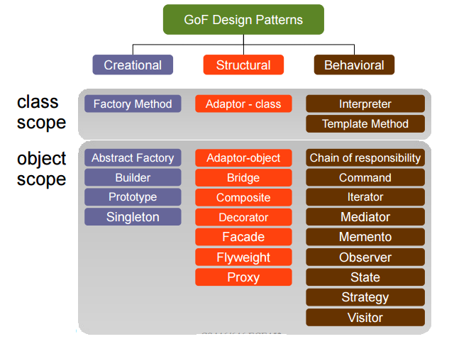
Design Pattern Classification

Slide 6
Design Pattern Classification
“Purpose” based classification
● creational: concerns with creation process of objects & classes
● structural: composition of classes & objects
● behavioral: characterizes interaction & responsibility of objects & classes
●“Scope” based classification : decided if the pattern applies to mainly classes or objects
Two categories
● class scope
  – relationship between classes & subclasses
  – statically defined at run-time
● object scope
  – object relationships (what type?)
  – can be manipulated at runtime (so what?)

Slide 7
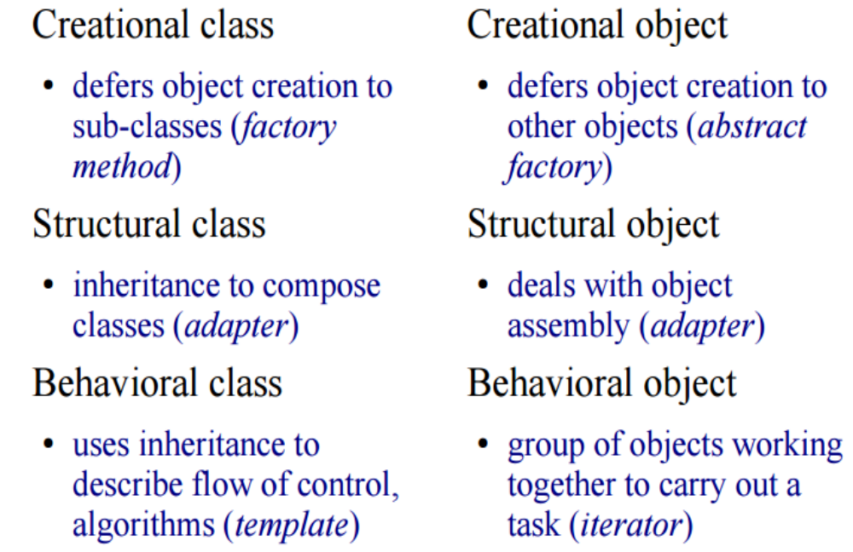
Design Pattern Classification

Slide 8
GOF Patterns
Creational Design Patterns
Structural Design Patterns
Behavioral Design Patterns
Applying Design Patterns

Slide 9
Creational Design Patterns
“Creational design patterns are design patterns that deal with object creation mechanisms, trying to create objects in a manner suitable to the situation”.
Creational design patterns abstract the instantiation process. There are two recurring themes in these patterns.
First, they all encapsulate knowledge about which concrete classes the system uses.
Second, they hide how instances of these classes are created and put together.
Types:
Factory Method
Abstract Factory
Builder
Prototype
Singleton

Slide 10
Abstract Factory
1) Implement a user interface toolkit that supports multiple looks and feel standards such as Motif, Windows 95 or the finder in MacOS.
How can you write a single user interface and make it ortable across the different look and feel standards for these window managers?
2) Implement a facility management system for an intelligent
house that supports different control systems such as Siemens’ Instabus, Johnson & Control Metasys or Zumtobe’s proprietary standard.
How can you write a single control system that is independent from the manufacturer?

Slide 11
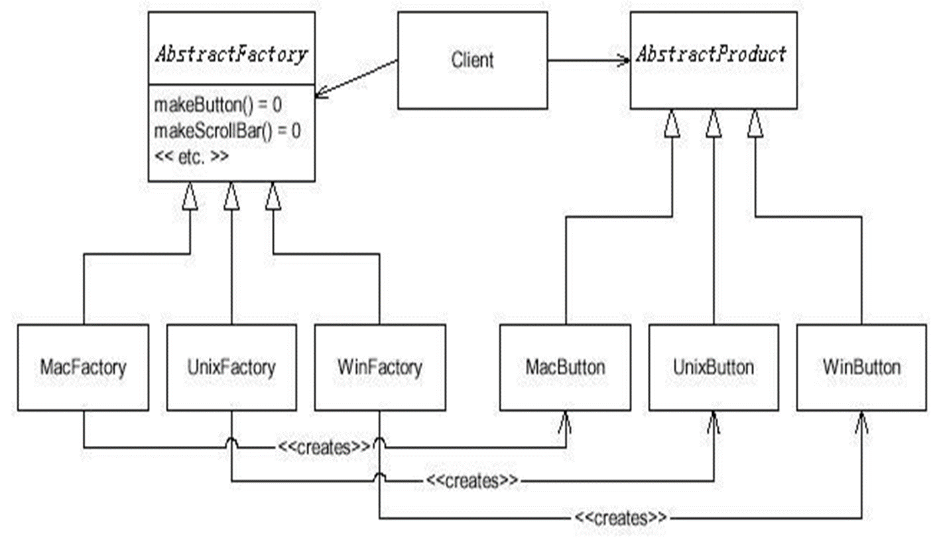
Abstract Factory

Slide 12
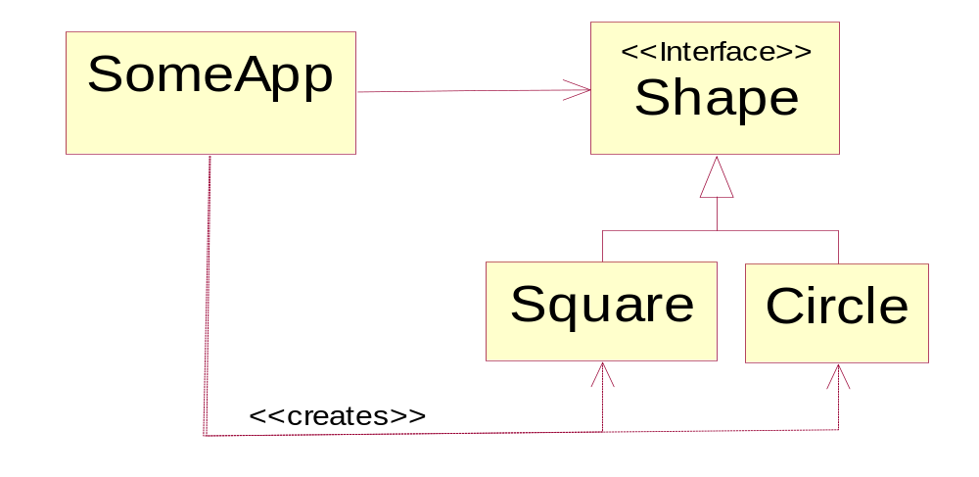
Abstract Factory - Example
We have a class named SomeApp that depends on the interface Shape.
Shape uses instances of Shape solely through the Shape interface.
Problem: SomeApp also creates instances of Square and Circle and thus has to depend on the concrete classes.

Slide 13
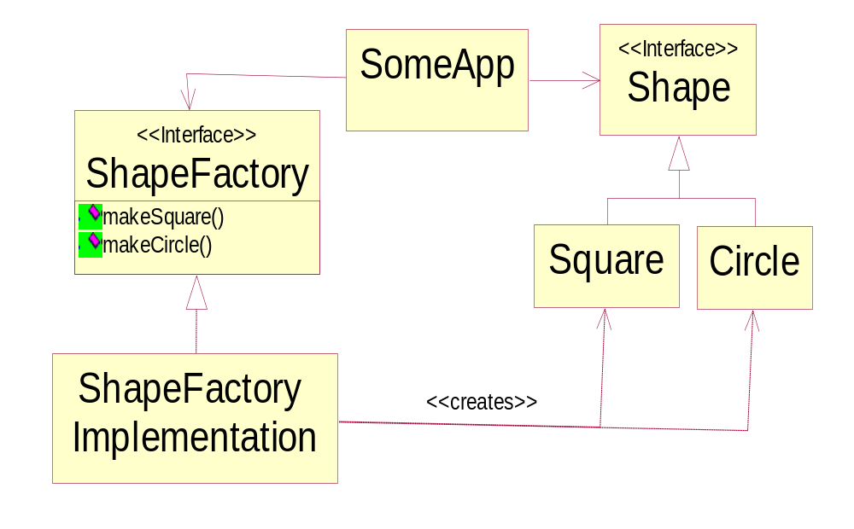
Abstract Factory - Example
Solution: ShapeFactory interface.

Slide 14
Abstract Factory - Example
Intent:
Provide an interface for creating families of related or dependent objects without specifying their concrete classes.
Applicability - Use the Abstract Factory pattern when
  1) Independence from Initialization or Representation:
  The system should be independent of how its products are created, composed or represented
  2) Manufacturer Independence:
  A system should be configured with one of multiple family of products
  You want to provide a class library for a customer (“facility management library”), but you don’t want to reveal what particular product you are using.
  3) Constraints on related products
  A family of related products is designed to be used together and you need to enforce this constraint
  4) Cope with upcoming change:
  You use one particular product family, but you expect that the underlying technology is changing very soon, and new products will appear on the market.

Slide 15
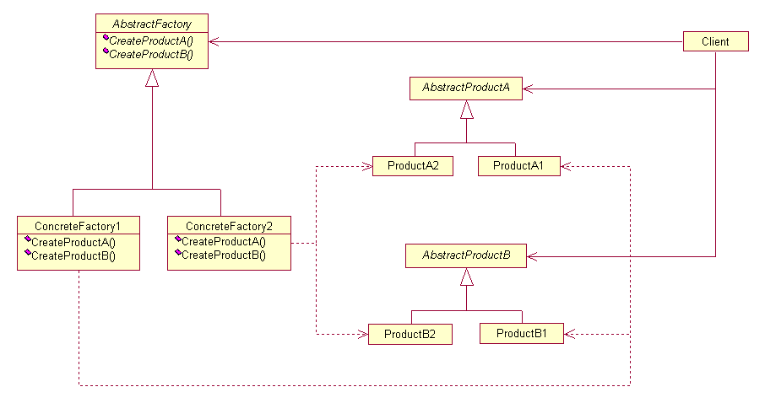
Abstract Factory - Example

Slide 16
Factory Method - example
For example, a framework for a windowing application has a class Application which must create an object of class Document
But the actual applications and documents are not written yet!
Solution:
Let subclasses decide which objects to instantiate
Application subclasses redefine an abstract CreateDocument operation on Application to return the appropriate Document subclass.
Once an Application subclass is instantiated, it can then instantiate application-specific Documents without knowing their class.
We call CreateDocument a factory method because it's responsible for "manufacturing" an object.

Slide 17
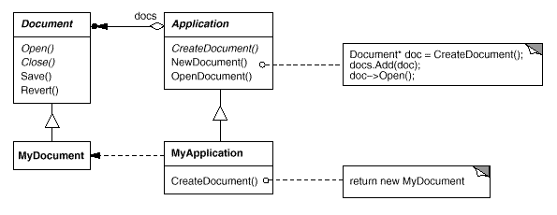
Factory Method - example
Separate creation into a method
the factory method in the MyApplication class:
public Document CreateDocument() { return new MyDocument();}
client code:
public Application app1;
app1 = new MyApplication();
app1.CreateDocument();

Slide 18
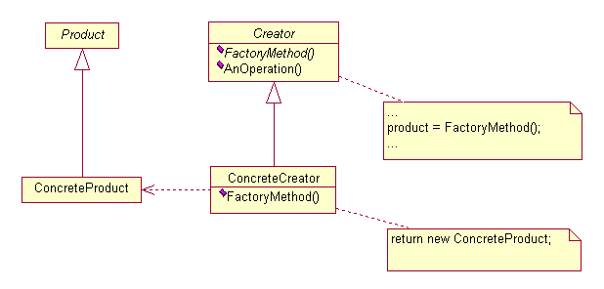
Factory Method
Intent:
  Define an interface for creating an object, but let subclasses decide which class to instantiate.
  Factory Method lets a class defer instantiation to subclasses.
Structure

Slide 19
Singleton
Intent - “ensure a class only has one instance, and provide a global point of access to it.”
Advantages
● controlled access to the class instance(s)
– can dictate who, and when a client can access
● refinement of functionality
– via inheritance/subclass

Slide 20
Singleton
singleton class responsible for creation
– acts as a builder/factory
what if we were to separate the two concerns
– example
database connection as a singleton
system 1 uses a singleton to ensure only a single database connection
system 2 needs to connection pool of 10 databases connections

Slide 21
Adapter
“convert the interface of a class into another interface... Adapter lets classes work together that couldn't otherwise because of incompatible interface”
● also known as “wrapper”
● boolean values can be represented by
– {1,0}, {true, false}, {yes, no}

Slide 22
Adapter Pattern
1) “Convert the interface of a class into another interface expected by the client. Adapter lets classes work together that couldn’t otherwise because of incompatible interfaces
2) Used to provide a new interface to existing legacy components (Interface engineering, reengineering).
3) Also known as a wrapper
4) Two adapter patterns:
Class adapter:
- Uses multiple inheritance to adapt one interface to another
Object adapter:
- Uses single inheritance and delegation
5) We will mostly use object adapters and call them simply adapters

Slide 23
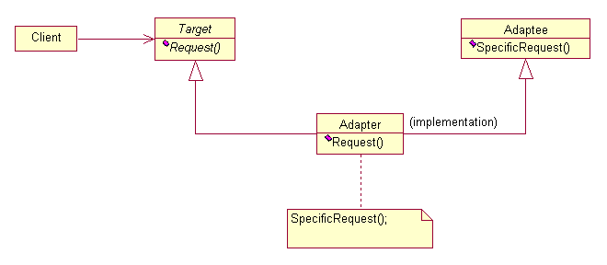
Adapter
Intent:
Convert the interface of a class into another interface clients expect. Adapter lets classes work together that couldn't otherwise because of incompatible interfaces.
Structure

Slide 24
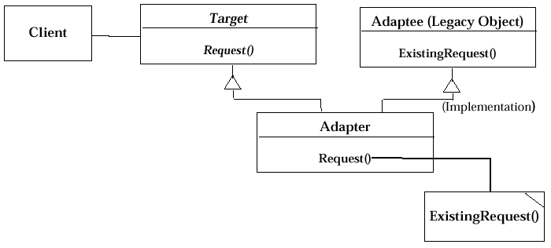
Class Adapter Pattern
Class Adapter Pattern (based on Multiple Inheritance)

Slide 25
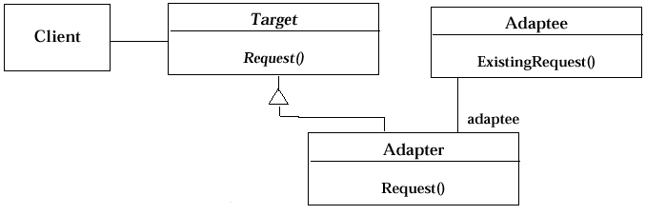
Adapter pattern uses delegation and inheritance
Adapter pattern uses delegation and inheritance
Delegation is used to bind an Adapter and an Adaptee
1) Interface inheritance is use to specify the interface of the Adapter class.
2) Adaptee, usually called legacy system, pre-exists the Adapter.
3) Target may be realized as an interface in Java.

Slide 26
Bridge Pattern
Decouple an abstraction or interface from its implementation so that the two can vary independently.
Bridge makes a clear-cut between abstraction and implementation.
Where to use
•When you want to separate the abstract structure and its concrete
implementation.
•When you want to share an implementation among multiple objects,
•When you want to reuse existing resources in an 'easy to extend' fashion.
•When you want to hide implementation details from clients. Changes in
implementation should have no impact on clients.
Benefits
Implementation can be selected or switched at run-time. The abstraction and implementation can be independently extended or composed.

Slide 27
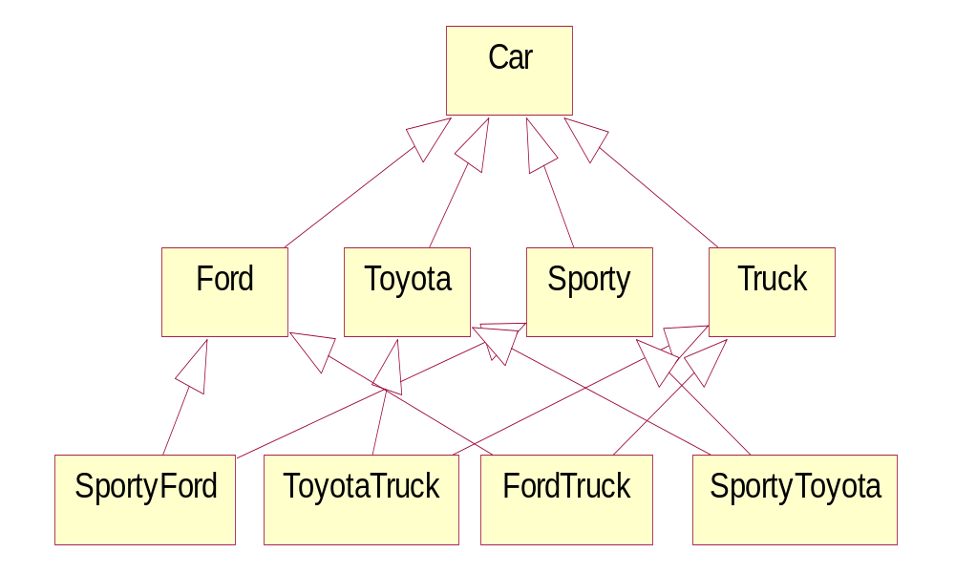
Usage example
Bridge pattern can be found in the AWT package. The AWT separates the general abstraction of GUI components from concrete native implementations of GUI components.

Slide 28
Composite Pattern
The Composite pattern helps you to create tree structures of objects without the need to force clients to differentiate between branches and leaves regarding usage. The Composite pattern lets clients treat individual objects and compositions of objects uniformly.
Where to use
•When you want to represent a part-whole relationship in a tree structure.
•When you want clients to be able to ignore the differences between compositions of objects and individual objects.
•When the structure can have any level of complexity and is dynamic.
Benefits
•Define class hierarchies consisting of primitive objects and composite objects.
•Makes it easier to add new kind of components.

Slide 29
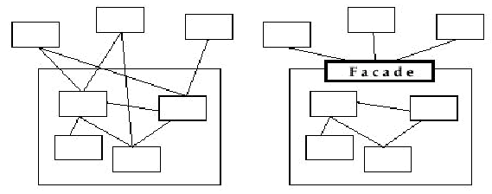
Design Patterns - Facade Pattern
Facade Pattern
1) Provides a unified interface to a set of objects in a subsystem. A facade defines a higher-level interface that makes the subsystem easier to use (i.e. it abstracts out the gory details)
2) Facades allow us to provide a closed architecture

Slide 30
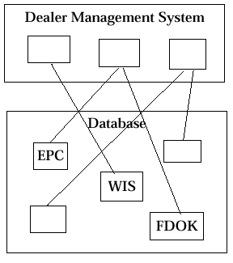
Design Patterns - Open vs Closed Architecture
Open vs Closed Architecture
1) Open architecture:
w Any dealer management system can call any component or class operation of the PAID databases.
2) Why is this good?
w Efficiency
3) Why is this bad?
Can’t expect the client to understand how the subsystem works or any of the complex relationships that may exist within the subsystem.
We can (pretty much) be assured that the subsystem will be misused, leading to non-portable code

Slide 31
Decorator Pattern
Widget Example
  Suppose you have a user interface toolkit and you wish to make a border or scrolling feature available to clients without defining new subclasses of all existing classes.
  The client "attaches" the border or scrolling responsibility to only those objects requiring these capabilities.
  Widget* aWidget = new BorderDecorator(
  new ScrollDecorator(new TextView), 1);
  aWidget->draw();
Stream Example
  cascading responsibilities on to an output stream
  Stream* aStream = new CompressingStream(
  new ASCII7Stream(
  new FileStream( "fileName.dat" )));
  aStream->putString( "Hello world" );

Slide 32








Decorator Pattern
VisualComponent
draw()
TextView
Decorator
+component
draw()
draw()
component.draw()
ScrollDecorator
BorderDecorator
scrollPosition
borderWidth
draw()
draw()
super.draw()
scrollto()
drawBorder()
drawBorder()
Decorator subclasses are free to add operations for specific functionality.
For example, ScrollDecorator's ScrollTo operation lets other objects scroll the interface if they know there happens to be a ScrollDecorator object in the interface.

Slide 33
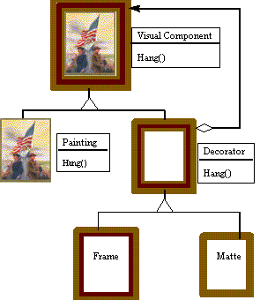
Decorator Pattern
Painting Example
  Although paintings can be hung on a wall with or without frames, frames are often added, and it is the frame which is actually hung on the wall.
  Prior to hanging, the paintings may be matted and framed, with the painting, matting, and frame forming a single visual

Slide 34
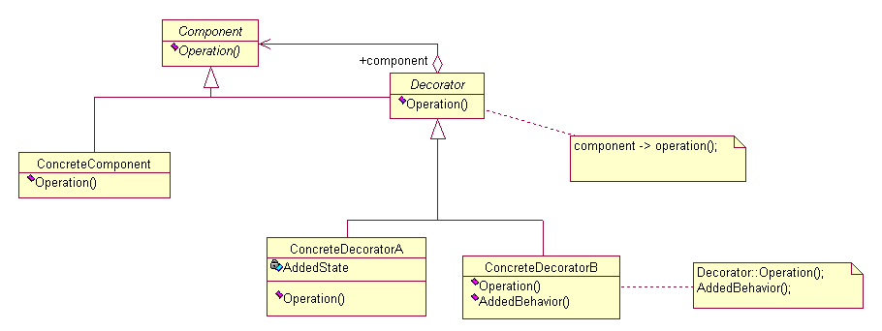
Decorator Pattern - Structure
Intent
  Attach additional responsibilities to an object dynamically.
  Decorators provide a flexible alternative to subclassing for extending functionality.
Structure
Structure

Slide 35
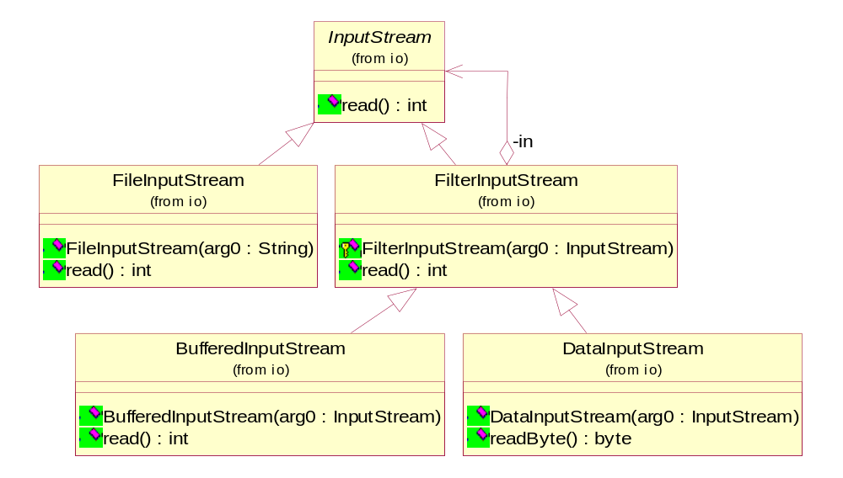
Decorator Pattern – Example(TestEoF.java)

Slide 36
Proxy Pattern
What is expensive?
  Object Creation
  Object Initialization
Defer creation and initialization to the time you need the object
Reduce the cost of access to objects
  Use another object (“the proxy”) that acts as a stand-in for the real object
  The proxy creates the real object only if the user asks for it

Slide 37
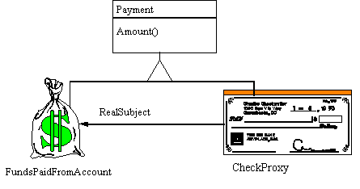
Proxy Pattern - Motivation
Example
  The Proxy provides a surrogate or place holder to provide access to an object.
  A check or bank draft is a proxy for funds in an account.
  A check can be used in place of cash for making purchases and ultimately controls access to cash in the issuer's account.

Slide 38
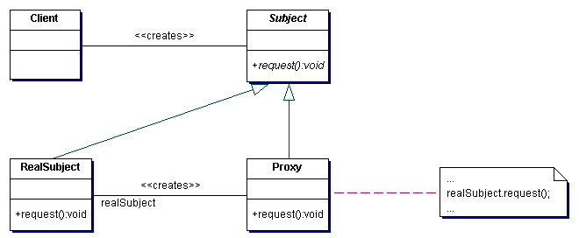
Proxy Pattern - Structure
Intent
  Provide a surrogate or placeholder for another object to control access to it.
Problem
  You need to support resource-hungry objects, and you do not want to instantiate such objects unless and until they are actually requested by the client.
Structure

Slide 39
Behaviour Design Pattern
“Behavioral design patterns are design patterns that identify common communication patterns between objects and realize these patterns. By doing so, these patterns increase flexibility in carrying out this communication.”
Behavioral patterns are patterns that focuses on the interactions between cooperating objects.
The interactions between cooperating objects should be such that they are communicating while maintaining as loose coupling as possible.

Slide 40
Observer pattern
Also known as: “Publish / Subscribe,” “Model / View,” and “Source / Listener.”
Motivation: Two File Managers are both observing the same Directory; the user
deletes a subdirectory using File Manager A; we want File Manager B to
immediately and automatically get updated, reflecting the change...
Applicability:
– When there are multiple views of a model (subject) that need to stay in sync.
No view should know about any other.
– When an object needs to communicate to other objects of unknown type (but known Observer interface) it can notify them.
Pros:
– Promotes loose coupling between objects.
– Excellent communication protocol.
– Avoids polling
Cons:
– None. Knowledge of this pattern is essential.

Slide 41
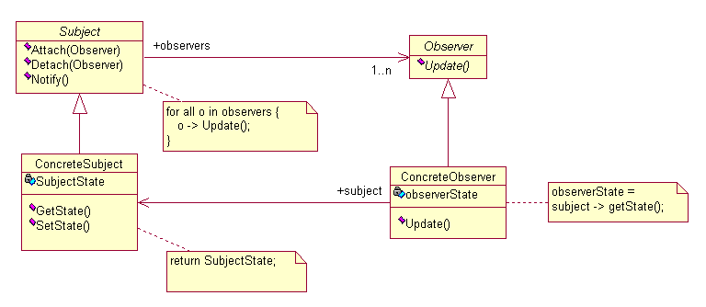
Observer pattern
Intent: Define a one-to-many dependency between objects so that when one object changes state, all its dependents are notified and updated automatically.

Slide 42
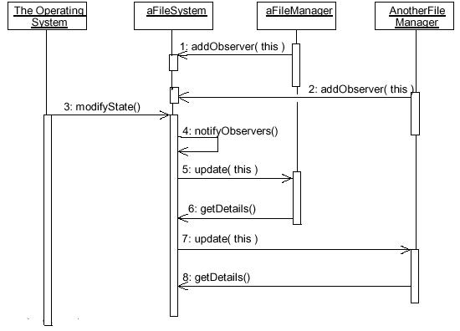
Observer pattern Example

Slide 43
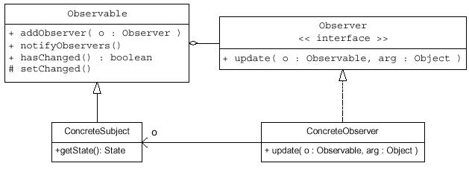
Java Support for Observer
 The java.util package provides an Observable class and an Observer interface:

Slide 44
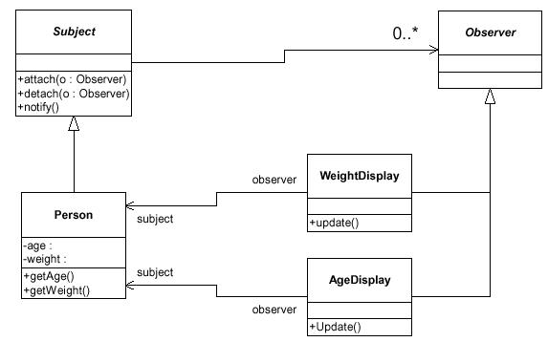
Example: A GUI Observes a Person

Slide 45
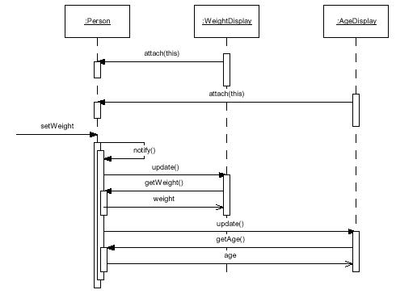
Example: A GUI Observes a Person

Slide 46
Example: Event-driven programming
In the case of a JButton, this “event of interest” is that the button is pressed. To register your interest in when a button is pressed, you call the JButton’s addActionListener( ) method. This method expects an argument that is an object that implements the ActionListener interface, which contains a single method called actionPerformed( ). So all you have to do to attach code to a JButton is to implement the ActionListener interface in a class, and register an object of that class with the JButton via addActionListener( ). The method will be called when the button is pressed (this is normally referred to as a callback).
<<Interface>>
Event handler
Event Sources
EventListener
Button2
JButton
(from util)
EventObject
init() : void
(from swing)
(from util)
getSource() : Object
<<Interface>>
ActionListener
AbstractButton
(from event)
AWTEvent
(from swing)
actionPerformed(arg0 : ActionEvent) : void
(from awt)
addActionListener(arg0 : ActionListener) : void
Events
Register event handler to event source
BL
(from Button2)
ActionEvent
actionPerformed(arg0 : ActionEvent) : void
(from event)
Notes:
In the Best Practices module, we discussed some characteristics common to successful projects. OO facilitates the following best practices:
Develop Iteratively
Model Visually
Use Component Architecture
Defining basic OO terms and concepts allows everyone in the class to start on a level playing field.

Slide 47
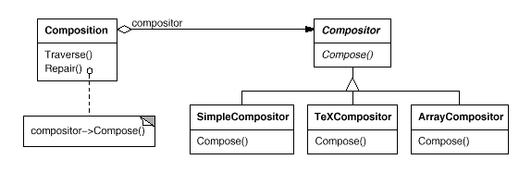
Strategy Pattern
Many algorithms exist for breaking a stream of text into lines. Hard-wiring all such algorithms into the classes that require them isn't desirable for several reasons:
Clients that need linebreaking get more complex if they include the linebreaking code. That makes clients bigger and harder to maintain, especially if they support multiple linebreaking algorithms.
Different algorithms will be appropriate at different times. We don't want to support multiple linebreaking algorithms if we don't use them all.
It's difficult to add new algorithms and vary existing ones when linebreaking is an integral part of a client.
We can avoid these problems by defining classes that encapsulate different linebreaking algorithms.
An algorithm that's encapsulated in this way is called a strategy.

Slide 48
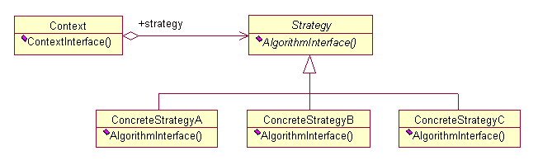
Strategy Pattern
Intent
  Define a family of algorithms, encapsulate each one, and make them interchangeable. Strategy lets the algorithm vary independently from the clients that use it.
Structure

Slide 49
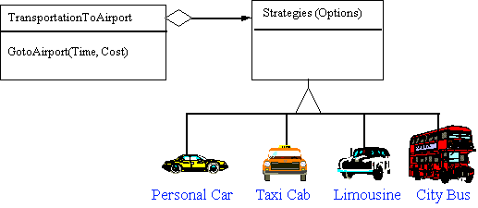
Strategy Pattern
A Strategy defines a set of algorithms that can be used interchangeably.
Modes of transportation to an airport is an example of a Strategy.
  Several options exist such as driving one's own car, taking a taxi, an airport shuttle, a city bus, or a limousine service.
  For some airports, subways and helicopters are also available as a mode of transportation to the airport.
  Any of these modes of transportation will get a traveler to the airport, and they can be used interchangeably.
  The traveler must chose the Strategy based on tradeoffs between cost, convenience, and time.

Slide 50
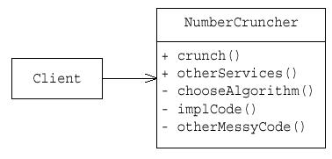
Strategy Pattern – Example
In this inflexible example, all the NumberCruncher code is in one big class… Why is this bad?
Strategy is similar to Bridge; same basic structure; very different intent.
The Strategy pattern is also similar to State, which allows a class to be configured with different behaviors from which it can select whenever it makes an interesting state transition.

Slide 51
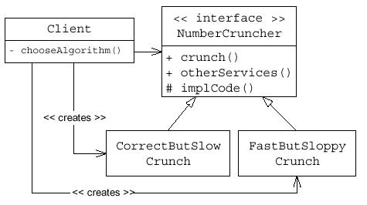
Strategy Pattern
What if there were not a CrunchAlgorithm interface… suppose instead that NumberCruncher had two subclasses, CorrectButSlowNumberCruncher, and FastButSloppyNumberCruncher…? Why is this bad?

Slide 52
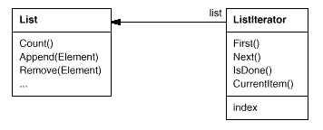
Iterator Pattern
An aggregate object such as a list should give you a way to access its elements without exposing its internal structure.
The key idea is to take the responsibility for access and traversal out of the list object and put it into an iterator object.

Slide 53
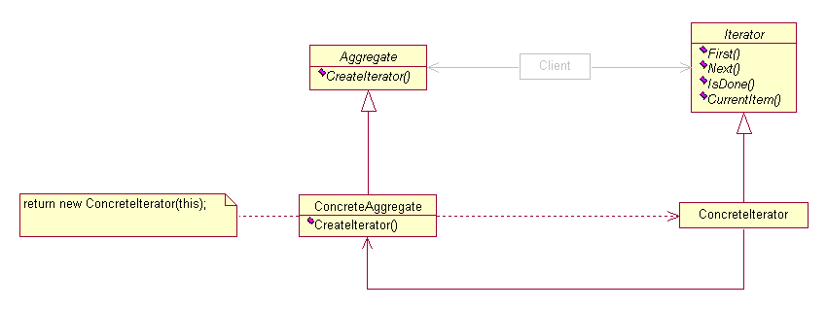
Iterator Pattern
Intent
  Provide a way to access the elements of an aggregate object sequentially without exposing its underlying representation.
Structure

